Slide 1
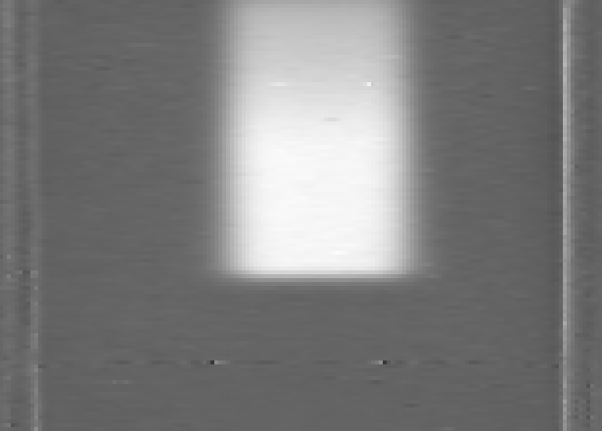
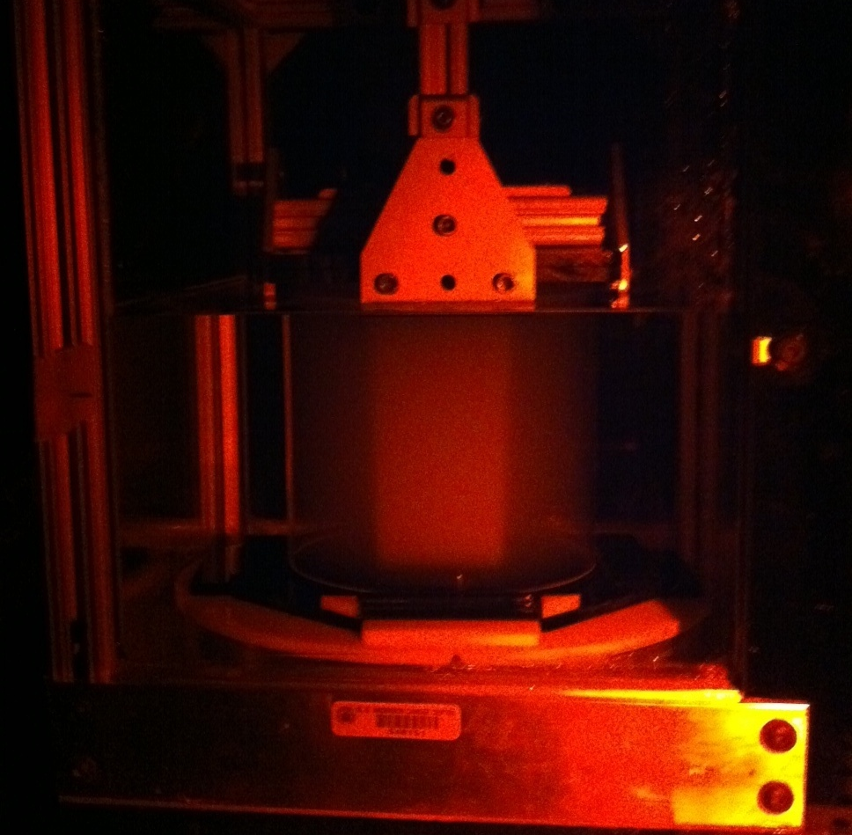
Three-Dimensional Measurements of Dose and LET from a Proton Beam via Polymer Gel Dosimetry K Vredevoogd^{1,2}, G Ibbott¹, M Gillin¹, N Sahoo¹, S Kry¹, K Gifford¹, M Maryanski³, (1) MD Anderson Cancer Center, Houston, TX, (2) UT Health Science Center at Houston Graduate School of Biomedical Sciences, Houston, TX, (3) MGS Research, Inc., Madison, CT Department of Radiation Physics, The University of Texas, M.D. Anderson Cancer Center, Houston, TX 77030
Introduction
As the complexity of radiation treatment modalities has increased, the need for a truly three-dimensional dosimetry system has arisen. Polymer gels, volumetric dosimeters in which irradiation induces a polymerization reaction that alters a number of physical characteristics (e.g. T₂ -relaxation rate, optical density) in the irradiated volume, may fulfill this need. These irradiated gels may be probed using a variety of modalities (e.g. Optical CT (OCT), MRI) to obtain dose information.
Great potential exists for gel dosimetry in proton therapy. The primary advantage of proton therapy lies in the energy deposition characteristics of protons. In particular, near the end of a proton’s range, the linear energy transfer (LET) increases dramatically in a region termed the Bragg peak. By utilizing the Bragg peak, dose to a tumor at depth may be increased while dose to surrounding normal tissue is minimized. As the Bragg peak is extremely localized, precise knowledge of its location during treatment is integral to accurate therapy. As such, gels could be powerful QA tools in ensuring the accurate three-dimensional positioning necessary in proton therapy. However, historically, gel response has been found to decrease in the high LET region of the proton dose distribution.
Recent advances in gel dosimetry have lead to gel dosimeters both insensitive to LET, yielding accurate proton dose distributions, and hypersensitive to LET, leading to an overresponse near the end of the proton’s range. The aim of this study was to measure dose and assess LET response using different formulations of BANG polymer gel dosimeters (MGS Research, Inc., Madison, CT) in proton beams.
Methods/Materials cont’d.
Irradiations were performed using a 200 MeV passively scattered proton beam with a 4 cm spread-out Bragg peak (SOBP) and a 4x4 cm² aperture. A physical dose of 3 Gy was delivered to the center of the SOBP for the BANG3-Pro2 and LET-baseline dosimeters, and 6 Gy was delivered to the LET-meter dosimeter. Additionally, gels were irradiated with 16MeV electrons and compared against calculated dose distributions from the Pinnacle treatment planning system to produce a optical density to dose calibration curve.
Dosimeters were read out using the OCTOPUS-IQ (MGS Research, Inc, Madison, CT) OCT scanner. A sample readout from a proton beam irradiation is shown in Figure 2.
For the BANG3-Pro2 dosimeter, the optical densities measured in the gel were compared against ion chamber data to assess the accuracy of the dosimeter. For the LET gel pair, LET-meter gel overresponse was quantified and compared against an LET curve created using an analytical LET model [1], shown in Figure 3.
All depth dose profiles were taken along the central axis of the proton beam. All distances were corrected to depths in water based on a constant stopping power ratio of 1.085 for the gels used in this study [2,3].
Results/Discussion cont’d.
Excluding data past the depth of 10% dose, 91% of points passed. A trend towards over-response was noted in the BANG3-Pro2 dosimeter towards the distal end of the SOBP, potentially implying a slight sensitivity to LET.
The responses of the LET-baseline and LET-meter dosimeters are shown in Figure 5.
The LET-meter dosimeter was found to have an optical density significantly higher than expected for a 6 Gy irradiation at the beginning of the SOBP – the gel’s optical density was 70% percent higher than that expected from the electron calibration curve. With a faulty calibration, analysis could only be preformed in the SOBP plateau, where the constant dose allowed for comparison without calibration.
The relationship between overresponse and LET is shown in Figure 6.
In agreement with earlier studies[3], response was found to be linear up to nearly 3.5 keV/micron. Little change in response was noted under a threshold LET of roughly 1.5 keV/micron.
Figure 5: The responses of the LET measurement dosimeters.
Figure 2: A coronal dosimeter slice produced by the OCTOPUS-IQ OCT scanner.
Methods/Materials
A total of three BANG variants were used in this study. The first, BANG3-Pro2, contains methacrylic acid monomers suspended in a high viscosity gelatin matrix and was used for dose measurements These dosimeters were sent in the form of BANGkits from MGS Research, Inc. Each BANGkit was comprised of a 0.5 L container of the primary dosimeter substance (methacrylic acid, gelatin, and water) plus three response-modifying additives. These ingredients were mixed and poured into 14.5 cm tall, 15 cm diameter acrylic cylinders. A sample dosimeter is shown in Figure 1.
The next two BANG variants were used for measurements of LET response. An LET-baseline gel was manufactured to be extremely insensitive to LET so as to provide LET-independent baseline data, and an LET-meter gel was manufactured to overrespond with a functional relationship to LET. Both gels were prepared by MGS Research, Inc., and were sent in the acrylic cylinders described above. During shipment and when not in use, all gels were kept refrigerated and away from light sources to avoid increases in the baseline optical density induced by light and heat.
Figure 3: The LET model for a 4 cm SOBP proton beam.
Figure 6: The LET response relationship across the SOBP.
Results/Discussion
The calibration curve and the depth dose profile obtained from the BANG3-Pro2 dosimeter are shown in Figure 4.
The dose response was found to be linear for doses above ~1.2 Gy; a second order polynomial fit was applied for lower doses. A correction based on gel underresponse near the bottom of the cylindrical volume was applied based on previously obtained commissioning data for the system (data not shown). After correction and calibration, 85% percent of points agreed with ion chamber data based on a 5%/3mm agreement criteria. Most failures occurred past the 10% depth dose point in the distal falloff of the SOBP, a region where noise from the scanner dominated the optical density reading.
Summary and Conclusions
BANG3-Pro2 kits can reproduce depth dose data from an SOBP proton beam with a high degree of accuracy. Slight LET effects may be present in the high LET region of the SOBP.
Across the range of LETs that could be investigated in this study, the LET-sensitive gel formulation showed a linear overresponse compared to the LET-baseline gel. Additional research into the dose-response characteristics of the LET-sensitive gel formulation will need to be performed in order to fully understand and utilize the capabilities of this new technology.
Figure 1: A BANG3-Pro2 polymer gel dosimeter in the OCTOPUS-IQ sample tank. The optically dense region in the center of the dosimeter was produced with 6MV photons.
Figure 4: (Left) The OD to dose calibration curve obtained from the BANG3-Pro2 polymer gel dosimeter. (Right) The BANG3-Pro2 dose measurement compared against ion chamber data.
References
1) J. J. Wilkens et al, Med Phys 30 (5), 806-815 (2003).
2) O.A. Zeidan et al, Med Phys 37 (5), 2145-2152 (2010).
3) O. Lopatiuk-Tirpak et al,Technol Cancer Res Treat, 2012 May [Epub ahead of print]
Contact: KMVredevoogd@mdanderson.org
Notes:
Figures – Gel Dosimeter image, calibration curve (dose and LET, probs),

